Slide 1
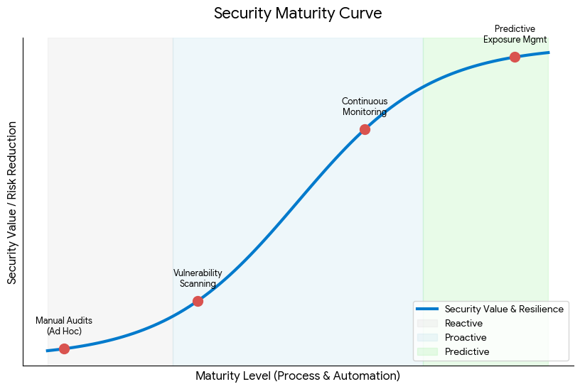
Transitioning from reactive snapshots to Continuous Assurance
Notes:
A Security Maturity Curve illustrates an organization's transition from reactive, manual processes to a proactive, data-driven security posture. According to industry frameworks like Tenable’s Exposure Management Maturity Model and Recorded Future’s maturity assessment, this shift typically follows four or five distinct stages:
Stages of the Security Maturity Curve
Ad Hoc / Basic Compliance (Manual Audits)
Focus: "Checking the box" for regulatory requirements.
Characteristics: Security is siloed and reactive. Processes rely on manual triage, investigation, and reporting using non-automated tools.
Outcome: Labor-intensive operations where many alerts go uninvestigated.
Defined / Vulnerability Scanning (Initial Automation)
Focus: Expanding visibility and establishing baseline policies.
Characteristics: Teams start to automate scans and checks in CI/CD pipelines. Basic project management techniques make successes repeatable.
Outcome: Improved awareness of existing vulnerabilities, though response remains largely manual.
Managed / Continuous Monitoring (Risk-Based)
Focus: Contextualizing risks and prioritizing remediation.
Characteristics: HTH can monitor and control our own processes through data collection and analysis. Security becomes embedded into daily workflows rather than just periodic documentation.
Outcome: Faster identification of potential risks before they become formal audit findings.
Optimized / Predictive Exposure Management (Automated & Real-time)
Focus: Anticipating and neutralizing threats before exploitation.
Characteristics: Systems use advanced analytics and AI for behavioral learning to predict potential breaches. Control moves from reactive patching to self-healing defense.
Outcome: Real-time intelligence informs every decision, allowing teams to limit impact quickly and maintain full audit readiness with automated evidence.

Slide 2
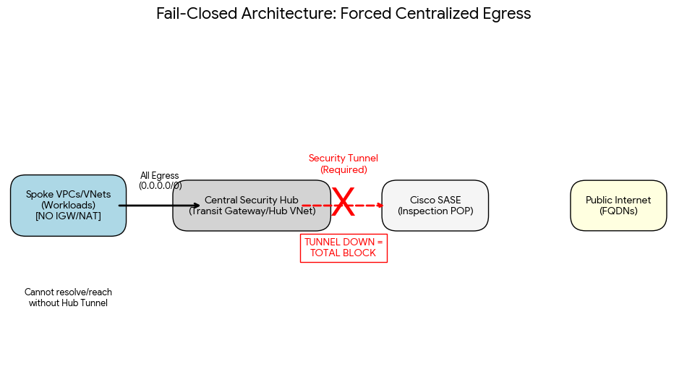
The Multi-Cloud Defensive Architecture
Notes:
This illustrates the "Fail-Closed" path where spokes (workloads) lack local Internet Gateways, requiring a tunnel to the central security hub for any external FQDN resolution.
Elimination of Shadow IT: By removing local Internet Gateways (IGWs), developers cannot bypass corporate security policy by spinning up new resources with direct internet access.
Zero Trust Compliance: This aligns with Zero Trust principles where no path is trusted by default; connectivity is a "privilege" granted only after passing through the inspection stack.
Audit Readiness: Because there is only one exit point, Cisco Secure Access provides a consolidated, 100% complete audit log of every external request made by cloud workloads.
Fail-Closed is a security design principle where a system's default state in the event of a failure is to deny all access rather than allow it.
If the security inspection layer ( Cisco SASE tunnel or Hub) goes offline, the network "fails closed," meaning the connection to the internet is physically severed for all cloud workloads.
What is it for?
It is a "security-first" safety switch. In the hub-and-spoke model, it ensures that uninspected traffic can never leave the environment. By removing local Internet Gateways from AWS/Azure spokes, you create a "choke point" at the Central Hub. If that hub cannot verify the safety of a request through Cisco SASE, the request is simply dropped.
Why it is critical for the Enterprise
Prevention of "Dark Egress" In a "Fail-Open" environment, if the security stack fails, traffic bypasses inspection to keep the business running. This creates a window of opportunity for malware to "phone home" to a Command & Control (C2) server or for an attacker to exfiltrate data while the defenses are down. Fail-Closed eliminates this window.
Absolute Policy Enforcement Enterprises in regulated industries (Finance, Healthcare, Gov) cannot afford "best effort" security. Fail-Closed provides a technical guarantee that 100% of outbound traffic is logged and inspected, ensuring no "Shadow IT" or rogue processes can bypass corporate governance.
Zero Trust Alignment Zero Trust assumes that the network is always hostile. A Fail-Closed architecture reinforces this by treating "lack of inspection" as a high-risk event. If the system cannot prove a connection is safe (because the inspection tool is broken), it assumes it is dangerous and blocks it.
Operational Forcing Function Because a failure results in a service outage rather than a silent security breach, it forces the organization to prioritize the health and redundancy of the security stack. It turns a "security problem" into a visible "operational priority," ensuring that the security infrastructure receives the same level of investment and uptime monitoring as the production applications themselves.
Summary for Executives:
"Fail-Closed means we would rather have a temporary outage that we can fix, than a permanent data breach that we didn't see."

Slide 3
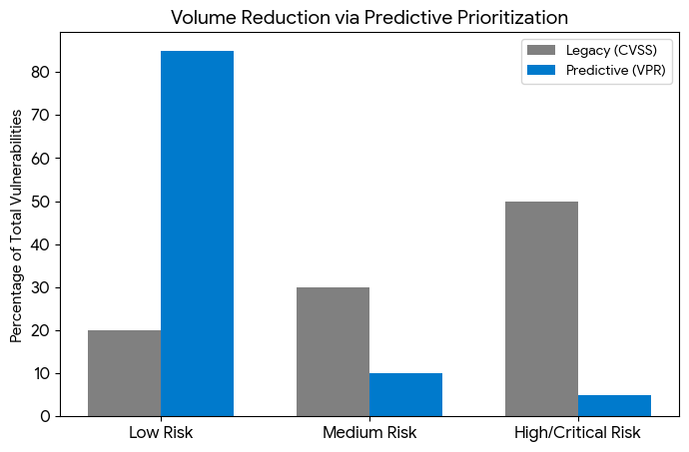
Predictive Risk Management (Tenable VPR)
Key Concept: Prioritizing the 1.6% of vulnerabilities that pose a real-world threat.
The graph demonstrates how VPR reduces "High/Critical" noise, allowing teams to hit the remediation SLA.
Notes:
Forcing all cloud egress through a Fail-Closed Cisco SASE hub transforms Predictive Risk Management (Tenable VPR) from a static reporting tool into an active enforcement engine. By centralizing the traffic path, Tenable’s Vulnerability Priority Rating (VPR) can be used to dynamically adjust security policies based on real-world exploitability.
For example, if Tenable identifies a high-VPR vulnerability within a specific AWS or Azure workload, the centralized hub can instantly restrict that workload's egress to only "known-good" FQDNs or block its external access entirely until the risk is remediated. This creates a closed-loop system: the predictive intelligence tells you which assets are most likely to be attacked, and the SASE hub provides the immediate, automated "kill switch" or granular filter to neutralize that risk before an exploit can occur.
Forcing all cloud egress through a Fail-Closed Cisco SASE hub transforms Predictive Risk Management (Tenable VPR) from a static reporting tool into an active enforcement engine. By centralizing the traffic path, Tenable’s Vulnerability Priority Rating (VPR) can be used to dynamically adjust security policies based on real-world exploitability. For example, if Tenable identifies a high-VPR vulnerability within a specific AWS or Azure workload, the centralized hub can instantly restrict that workload's egress to only "known-good" FQDNs or block its external access entirely until the risk is remediated. This creates a closed-loop system: the predictive intelligence tells you which assets are most likely to be attacked, and the SASE hub provides the immediate, automated "kill switch" or granular filter to neutralize that risk before an exploit can occur.
Why This Matters to Executives
Speed: It moves at "machine speed," neutralizing threats in seconds rather than the hours it takes for a manual ticket.
Precision: By using VPR instead of static scores (CVSS), you avoid "over-isolating" servers for vulnerabilities that aren't actually being exploited in the wild.
Resilience: It ensures that even if a server is compromised, the "Fail-Closed" hub prevents it from becoming a launchpad for further attacks.

Slide 4
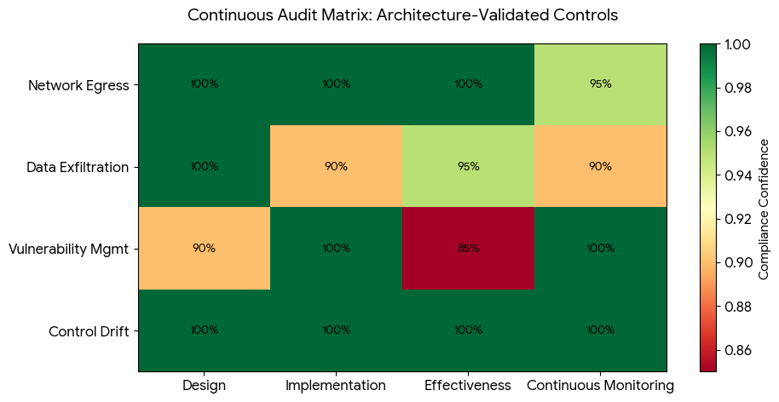
Continuous Audit Matrix
Notes:
A Continuous Audit Matrix in a Fail-Closed architecture shifts governance from "periodic sampling" to "real-time validation." By centralizing all traffic through a Cisco SASE hub and integrating Tenable VPR, the audit trail is no longer a manual collection of logs; it is an automated stream of evidence that proves every control is functioning as intended, 24/7.
The Governance Impact: From "Checklist" to "Matrix“
Automated Evidence Collection: Traditional audits rely on periodic screenshots. In this model, the Cisco SASE Hub provides a 100% complete log of all egress attempts, while Tenable VPR provides real-time risk scores. This creates a "Self-Auditing" environment where compliance is a byproduct of the architecture.
Enforcement as Governance: "Fail-Closed" is the ultimate governance control. It ensures that if the security policy cannot be verified (e.g., the hub is down), the data cannot leave. This meets "Duty of Care" standards by design, rather than by human oversight.
Predictive Compliance: By tracking Control Drift and Egress Block Rates, the matrix moves from identifying what happened to predicting where we are weak.
Our governance model is evolving from backward-looking reports to a Continuous Audit Matrix. Because our cloud spokes lacked local internet paths, every single outbound packet was an audited event. The integration with Tenable VPR allows us to audit not just the existence of a vulnerability, but our immediate, automated response to it. We don't just 'hope' we are compliant; the Fail-Closed architecture makes it mathematically impossible for an uninspected egress to occur without leaving a trace.

Slide 5
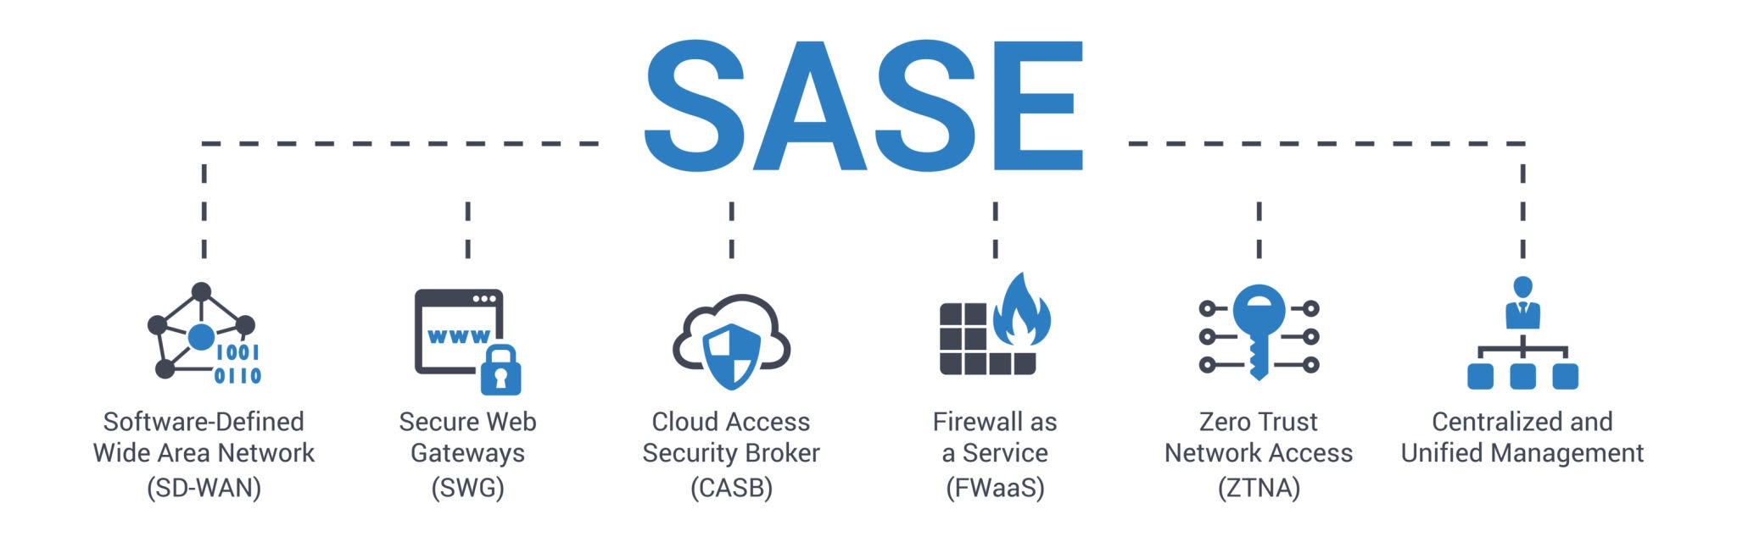
Egress Integrity & Data Exfiltration Protection
Key Concept: Identity-aware FQDN filtering and Cloud DLP via Cisco SASE.
SASE Framework where DNS-layer security acts as the primary barrier against data exfiltration to unauthorized financial domains or C2 servers.
Notes:
When you integrate Cisco SASE with Tenable Vulnerability Management and baseline monitoring, you move from "passive filtering" to Identity-Aware Egress Integrity. This creates a multi-layered defense where network connectivity is tied directly to the health of the asset.
How it Protects the Enterprise
1. Context-Aware Egress Integrity In a standard environment, a server is either "allowed" to the internet or not. In this integrated model, the SASE Hub asks a crucial question before every connection: "What is the current health of this requester?" If Tenable reports a high VPR score or a deviation from the Security Baseline (like an unauthorized open port), the SASE hub treats that egress attempt as a potential compromise. It doesn't just block based on the destination; it blocks based on the deteriorated integrity of the source.
2. Data Exfiltration "Kill-Switch" Data exfiltration often happens through stealthy, low-and-slow connections to reputable cloud storage or encrypted "gray" sites. By forcing all traffic through the SASE hub, you apply DLP (Data Loss Prevention) and TLS Decryption at the only exit point. If Tenable flags a workload as "At Risk," the SASE policy can automatically tighten—switching from "Allow Business Apps" to "Strict Restricted," effectively killing any exfiltration path before the data can be moved.
3. Baseline-Driven Anomaly Detection Continuous baseline monitoring establishes a "DNA profile" for the AWS/Azure workloads. If a workload suddenly attempts to connect to an external FQDN it has never visited, or via a protocol not in its baseline, the SASE hub triggers an immediate block. Because the architecture is Fail-Closed, there is no "dark path" for this traffic to take; it is forced into the inspection engine where the anomaly is caught.
4. Predictive Response to Zero-Days When a new high-priority vulnerability is released, Tenable updates the VPR score globally. The integrated SASE hub can proactively "Shield" vulnerable workloads by blocking the specific ports or protocols associated with that new threat across the entire cloud fabric simultaneously. This buys the team time to patch without leaving the data exposed to exfiltration.
"We are synchronizing our 'Security Brain' (Tenable) with our 'Security Gateway' (SASE). If an asset becomes risky or drifts from its baseline, its ability to send data out can be automatically revoked. We aren't just watching for bad destinations; we are ensuring that only healthy, compliant workloads are allowed to communicate with the world."

Slide 6
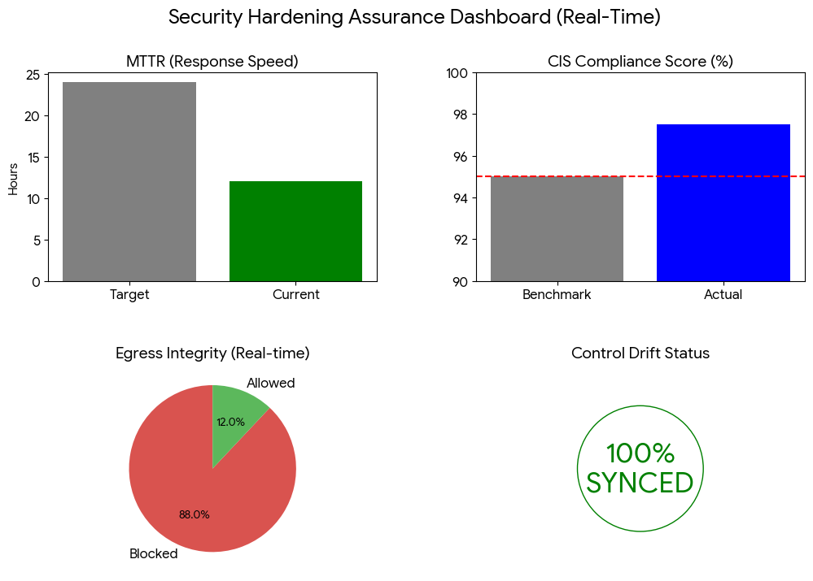
Performance Benchmarks
Notes:
The "Big Four" Hardening Benchmarks
In a Fail-Closed environment, these metrics prove that security isn't just a barrier, but a measurable operational standard.
MTTR (Mean Time to Remediate): Measures the speed of the automated response. By moving to a SASE-integrated model, the goal is to drive MTTR down from days to minutes for high-VPR threats.
CIS Compliance Score: A real-time audit of the AWS/Azure baseline. Maintaining a score >95% ensures that the "Fail-Closed" infrastructure itself is hardened against misconfigurations.
Egress Block Rate: Visualizes the "Signal-to-Noise" ratio. High block rates for "Critical Threats" prove the SASE hub is successfully neutralizing exfiltration attempts that would have bypassed a standard gateway.
Control Drift Status: Tracks "Security Integrity." This ensures that 100% of spokes are still routing through the Hub and haven't had "backdoor" Internet Gateways manually attached.

